Slide 1
Diabetic Retinopathy Detection
Kaggle Feb 2015 – July 2015
Github for tensorflow: @t-lanigan

Slide 2
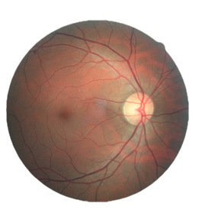
Diabetic Retinopathy
A disease associated with long-standing diabetes. Will eventually lead to vision loss.
40-45% of Americans with diabetes has this disease in some stage of development.
Hard to diagnose before it’s too late.

Slide 3
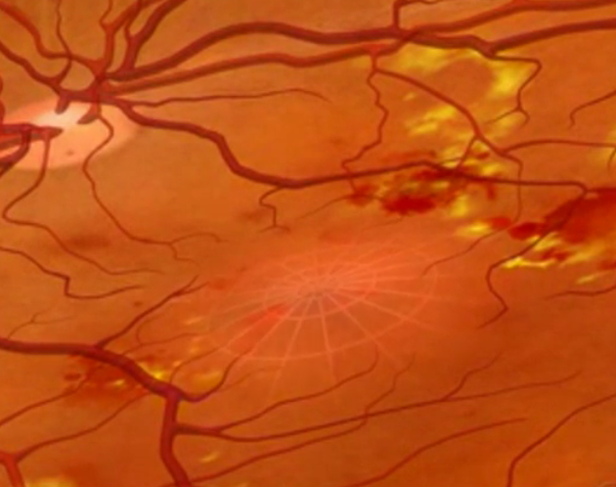
Non-proliferative diabetic retinopathy (NPDR)
Optic Nerve
Blood vessels are weakened in the eye due to high blood sugar level.
Tiny aneurisms form and bust in the eye causing retina to bulge and eye to un-focus.
Macula

Slide 4
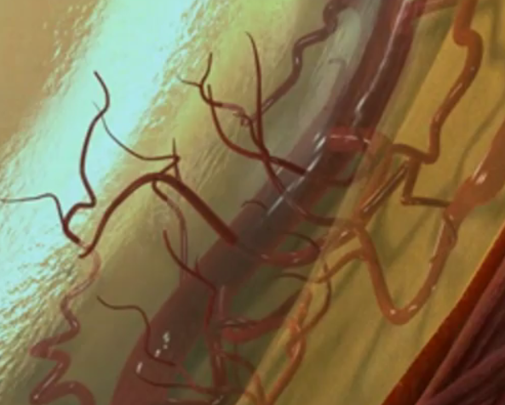
Proliferative diabetic retinopathy (PDR)
Circulation problems cause new blood vessels to form and grow in the retina and vitreous.
The new blood vessels may leak blood into the vitreous, clouding vision.

Slide 5
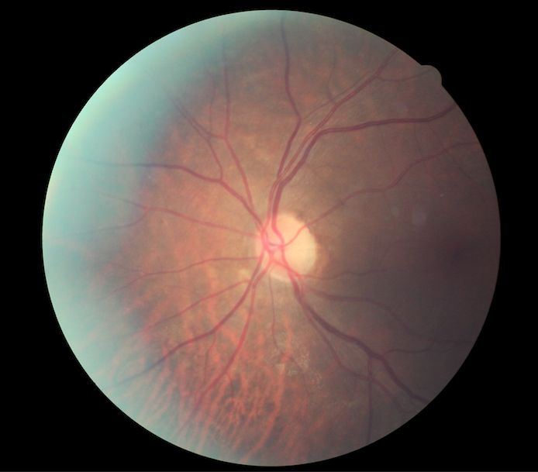
Image Classification Problem
Training Labels (ID, Class)
Training Image
10_left,0
10_right,0
15_left,1
15_right,2
16_left,4
16_right,4
Classes:
0 - No DR 1 – Mild
2 – Moderate
3 - Severe 4 - Proliferative DR

Slide 6
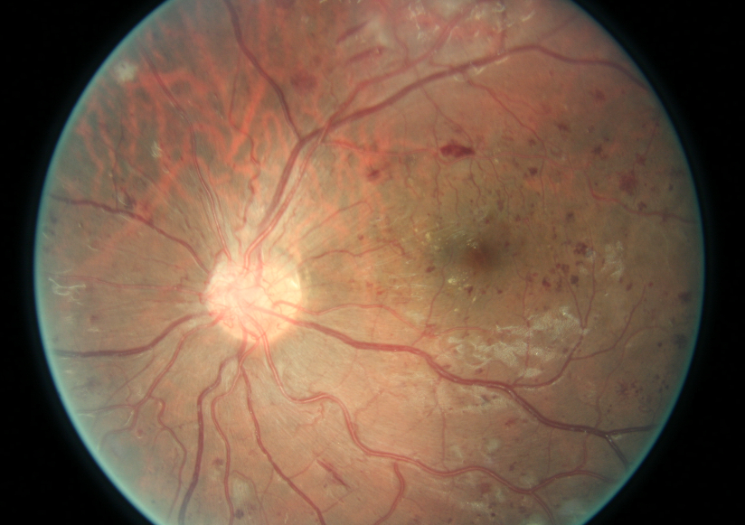
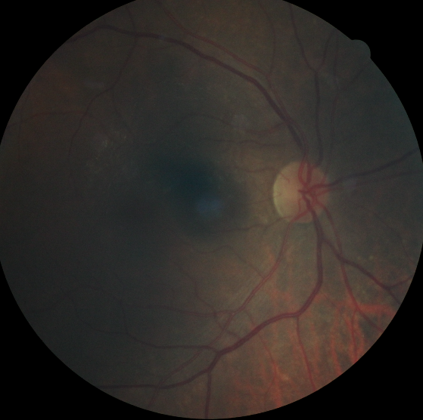
Data Hang-ups
Inverted and non inverted Images
Out of focus, different lighting

Slide 7
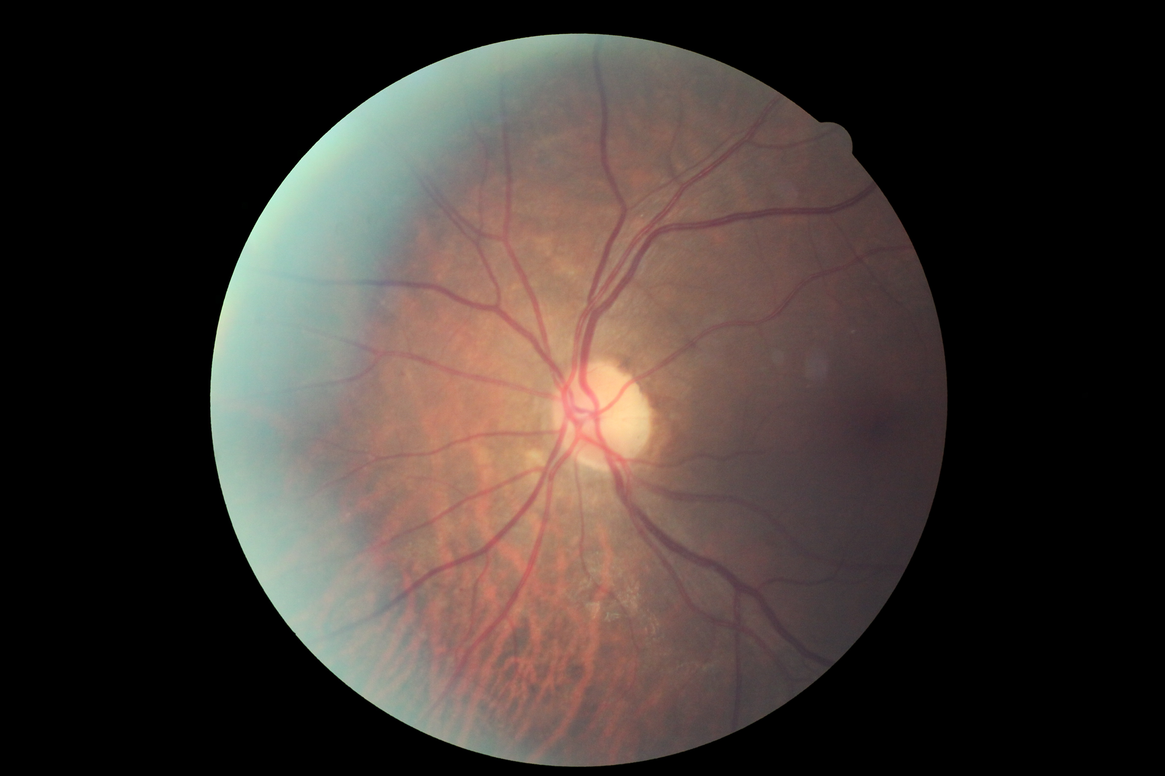
Class = 0
Non-inverted

Slide 8
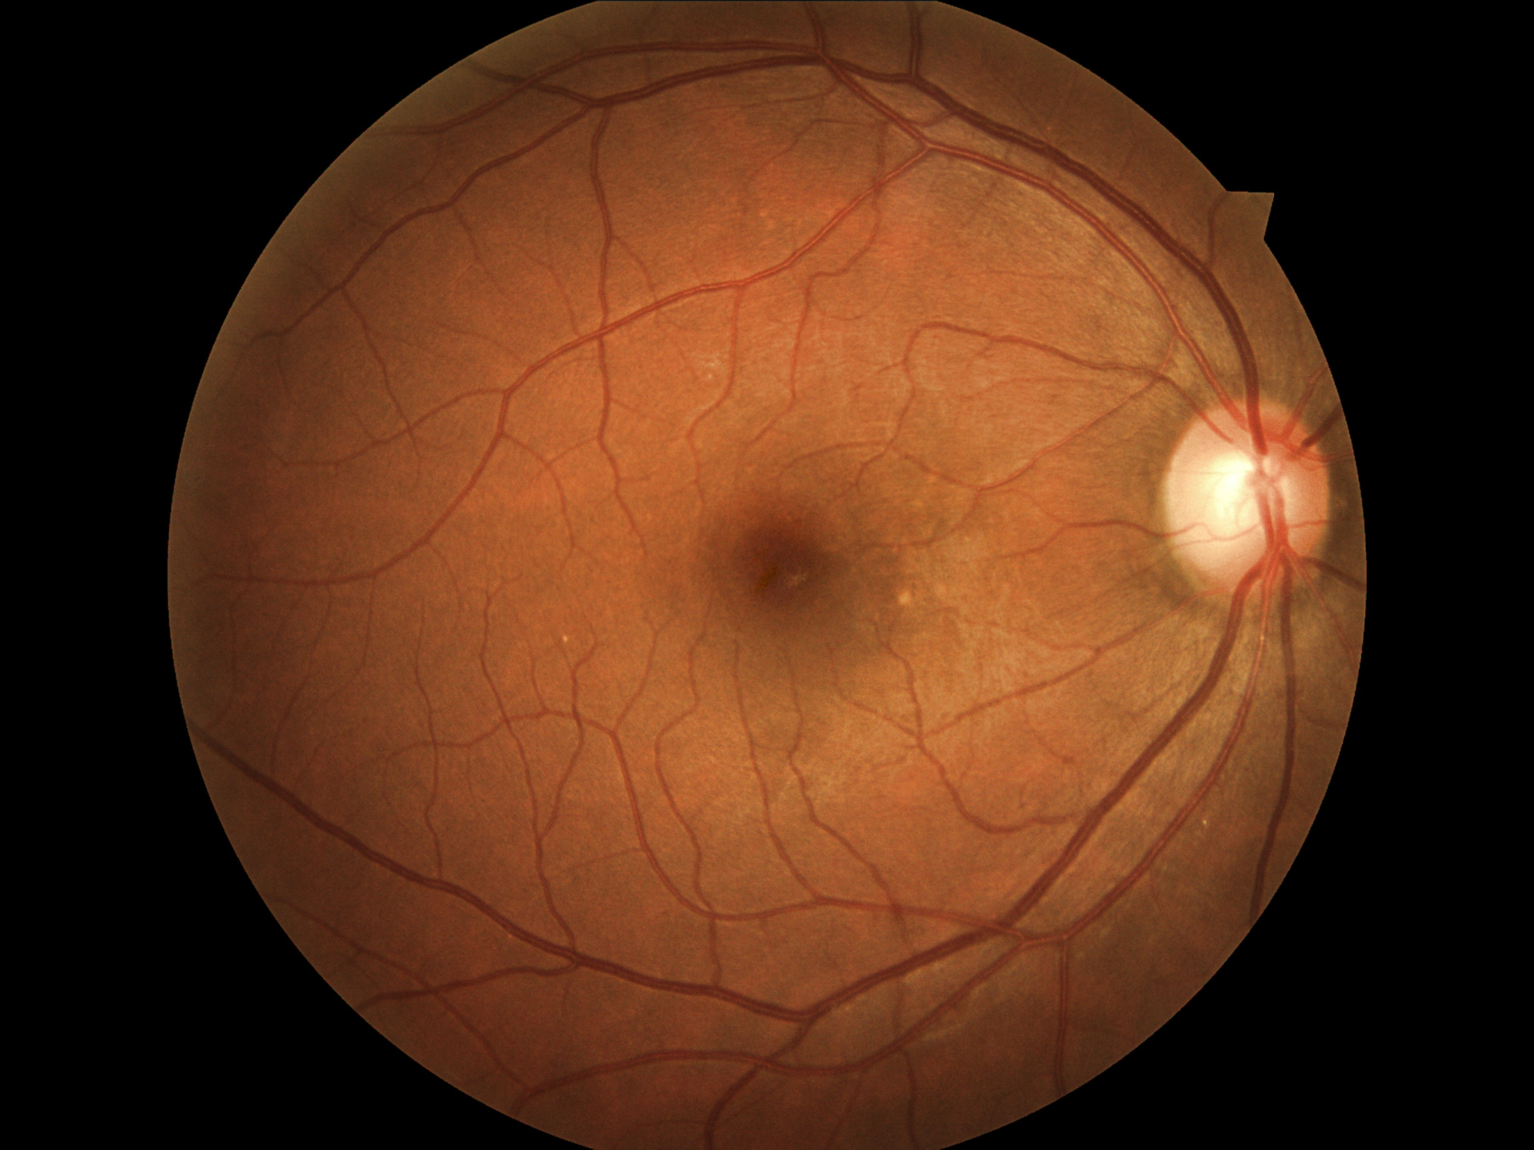
Class = 0
Non-inverted

Slide 9
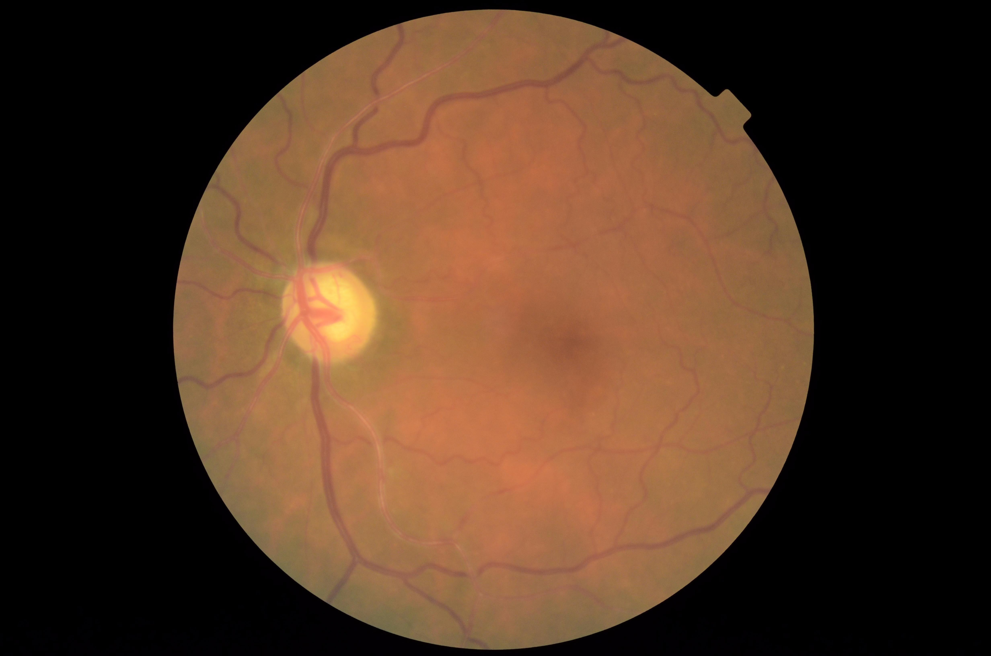
Class = 2
Non-inverted

Slide 10
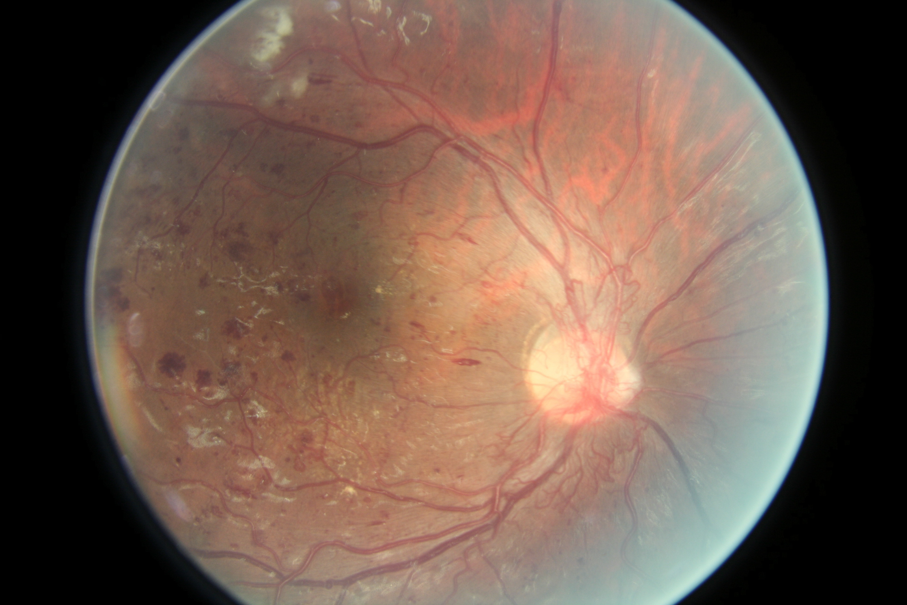
Class = 4
Inverted

Slide 11
Team O_o Solution
CNNs - 0.84479
Second Place
Github: https://github.com/sveitser/kaggle_diabetic

Slide 12
Feature Selection / Extraction
Resized images to square and centered 128, 256 and 512 pixel images.
That’s all!
Original Size ~3888 × 2592 - 2592 × 1944.

Slide 13
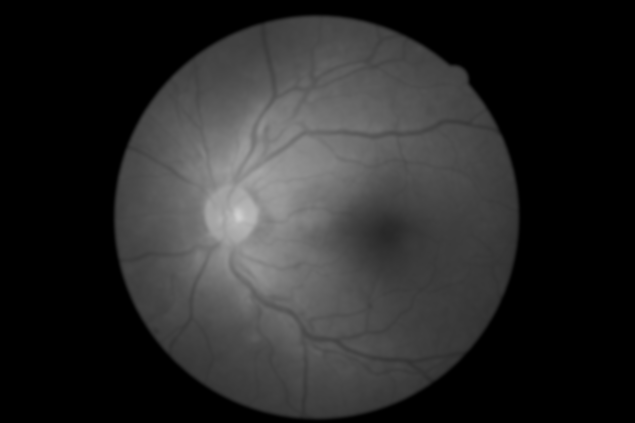
“The project was developed and tested on arch linux and hardware with a i7-2600k CPU, GTX 970 and 980Ti GPUs and 32 GB RAM. You probably need at least 8GB of RAM as well as up to 160 GB of harddisk space (for converted images, network parameters and extracted features) to run all the code in this repository.”
Team O_o

Slide 14
Summary of Network Architecture and Training
Programmed CNN using Lasagne and Theanos
For nonlinearity - leaky (0.01) rectifier units following each convolutional and fully connected (dense) layer.
Trained with Nesterov momentum with fixed schedule over 250 epochs.
Epoch 0: 0.003
Epoch 150: 0.0003
Epoch 200: 0.00003

Slide 15
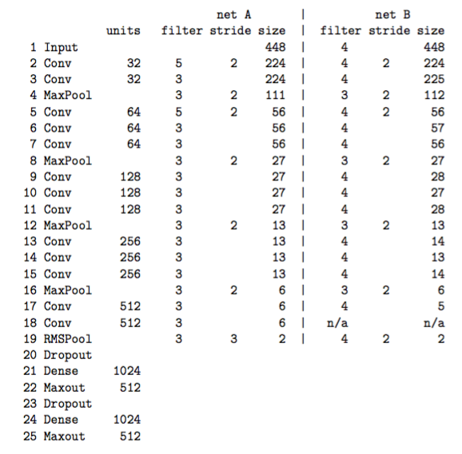

Slide 16
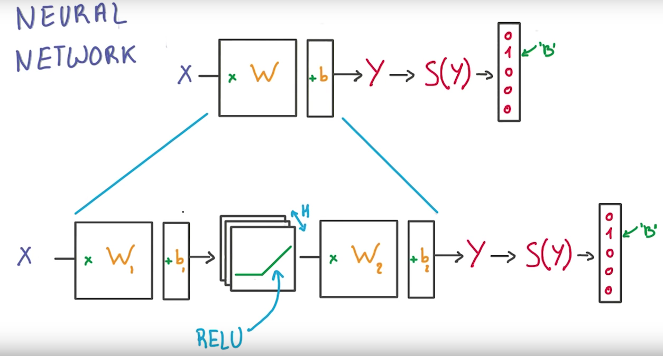
NNs in a nutshell

Slide 17
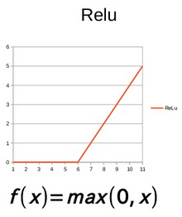
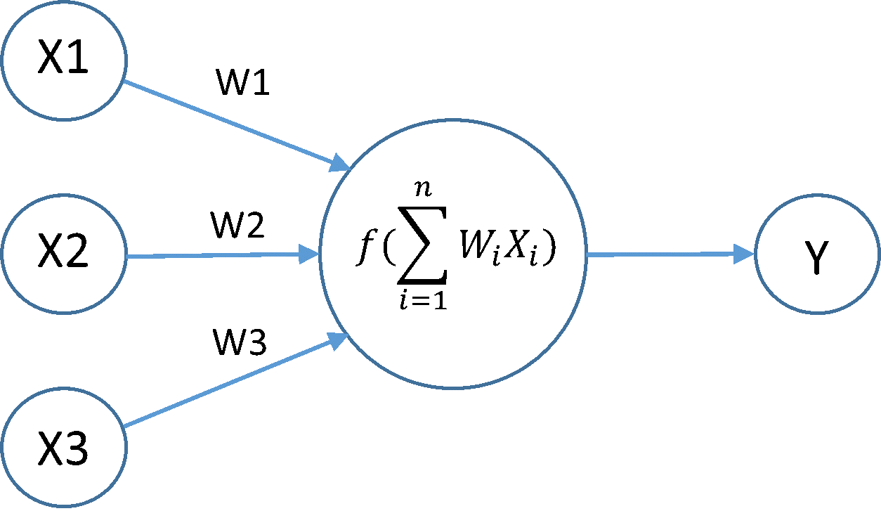
Linear Rectifier Units

Slide 18
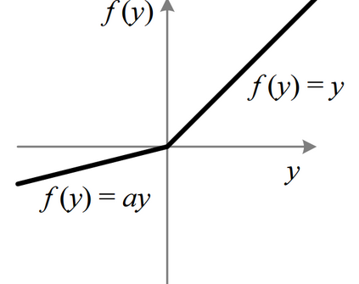
Leaky Rectifier Units
Unfortunately, ReLU units can be fragile during training and can “die”.
Leaky Rectifier Units are a function that gets around this.

Slide 19
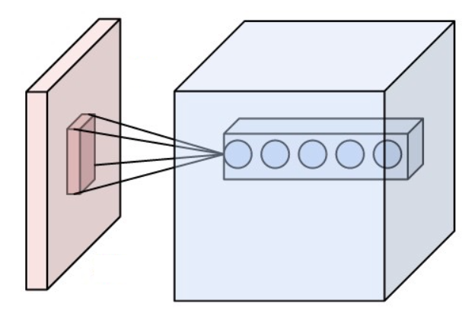
CNNs in a nutshell
Notes:
Each of the circles in a filter. Each will intuitively learn a feature such as an edge or a region of color.

Slide 20
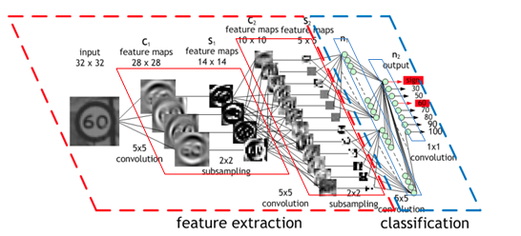

Slide 21
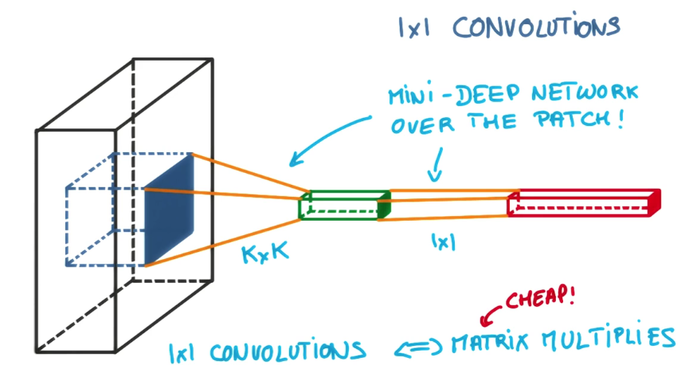
1x1 convolutions
Cheaply add more depth and parameters to your model.

Slide 22
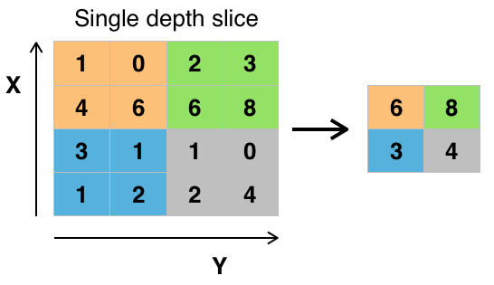
Max Pooling with 2x2 filter and stride of 2.

Slide 23
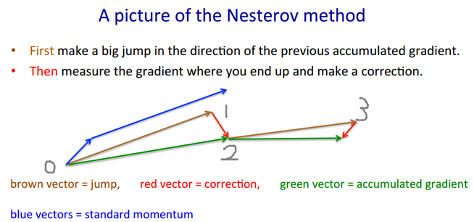
Nesterov momentum

Slide 24
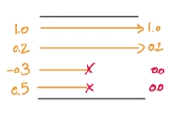
Dropout
Randomly set the output of activation function to 0 during training.

Slide 25
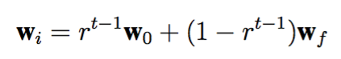
Resampling
Classes were very unbalanced (not very many class 4s)
Initially all classes were sampled equally, then gradually the rarer classes were sampled less during epoch t according to the formula:
where r, wo and wf are constants and vectors determined to work well in practise.

Slide 26
Initialization and ”Pre-training“ of Smaller Architectures
Initially trained on 128x128 network
Used trained weights to partially initialize 256x256 images
Used trained weights to partially initialize 512x512 images which were the final images used for classification.
Were able to get performance gain by switching up to 768. But not used in final solution.

Slide 27
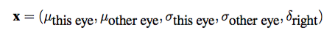
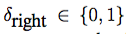
Feature Extraction on last layer
Repeat the training of the network up to 50 times for 50 different augmentations of the images (rotations, colour shifts, stretching, flipping etc.) The output sizes for the data augmentation pipeline are 112/224/448 pixel for the images.
use the mean and standard deviation of each feature, as well as an indicator variable for the right eye, as input to a blending network.

Slide 28
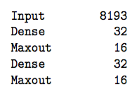
Blending Network
Increased score on leaderboard from 0.824 to 0.845
L1 regularization with factor 2e-5 is applied to the first layer and L2 regularization with
Factor 0.005 is applied on every layer.

Slide 29
Final Ensemble
Final solution is an average of six per patient blends for the two convolutional network architectures and three different set of trained weights (125, 256, 512)

Slide 30
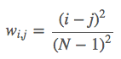
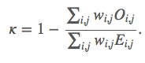
Evaluation
Submissions are scored based on the quadratic weighted kappa (cohen’s kappa), which measures the agreement between two ratings. This metric typically varies from 0 (random agreement between raters) to 1 (complete agreement between raters).
N = number of classes (5), i = human rating (1-5), j = prediction, w_i,j = weight matrix, Oi,j = histogram matrix, E_i,j = expected value matrix.

Slide 31
Evaluation continued…
It is generally thought to be a more robust measure than simple percent agreement calculation, since κ takes into account the agreement occurring by chance.
Weighted kappa is an extension of Cohen’s Kappa that heavily penalizes disagreements based on how far they are away from each other.

